Slide 1

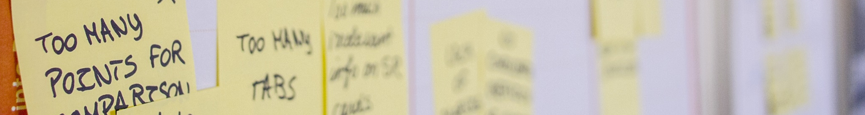
The planned development and installation of sustainable strategies, structures and processes that lead to organizational effectiveness
IMPROVE MY BIZ
Your one-stop shop for all things Organizational Development

Slide 2

IMPROVE
MY
BIZ

Slide 3
AGILE
Collaborative way of working with methods and practices that adapt to changing customer needs. Agile an be customized to fit a team‘s needs by using structured frameworks (such as SCRUM) or utilizing specific elements to improve a project.
Learn More

Slide 4
LEAN
Structured process used to improve the efficiency of a team in indirect areas. Through the use of various tools, processes and workshops, teams are offered a chance to deep dive into their business in order to eliminate waste and leverage areas that provide more value.
Learn More

Slide 5
ChM
(Change Management)
Processes, tools and techniques used to manage the people side of change. This framework helps individuals make successful personal transitions which results in the adoption and realization of the targeted change.
Learn More

Slide 6
OD
(Organizational Development)
Assess your organization in order to understand its strengths and weaknesses and then develop and implement strategies to improve the culture, people and processes
Organizational Development (OD)
OD is the planned development and installation of strategies, structures and processes that lead an organization to enhanced effectiveness. We can use OD to assess your organization’s strengths and weaknesses, and develop strategies to address them through the use of some of the methods mentioned below. Click here to learn more.
Learn More

Slide 7
Didn‘t find what you were looking for?
We offer additional services that can improve your biz. Click here to learn more.

Slide 8


Slide 9
CHANGE MANAGEMENT
LEAN
AGILE
OTHER SERVICES

